Slide 1
WEEK 4
Internship under dr gs javed sir
INTERN NAME - AFZAL MALIK
College/UNIVERSITY – ZAKIR HUSAIN COLLEGE OF ENGG. & TECH.
ALIGARH MUSLIM UNIVERSITY
COURSE- BACHELOR OF TECHNOLOGY (ELECTRONICS ENGG.)
YEAR – SECOND

Slide 2
WEEK 4 INTERNSHIP PLAN
One stage OPAMP
CS Amplifier using PMOS and current source load
Two stage OPAMP
SOFTWARE USED : LT Spice

Slide 3
SINGLE STAGE OPAMP
DESIGN AND SIMULATION using lt spice
Model file : 180n
SPECIFICATIONS
GBW=1GHz
At 100Mhz gain=10

Slide 4
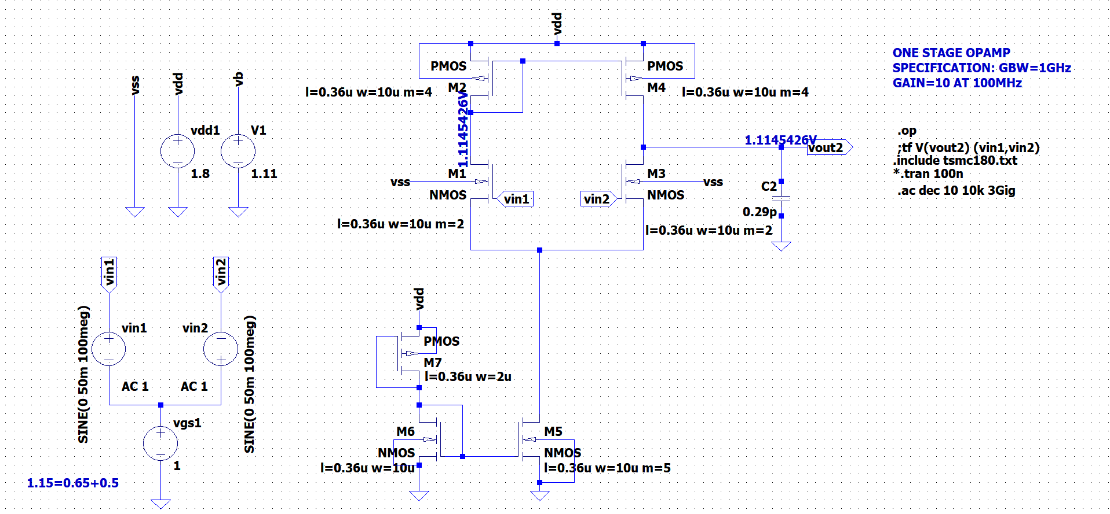
SCHEMATIC

Slide 5
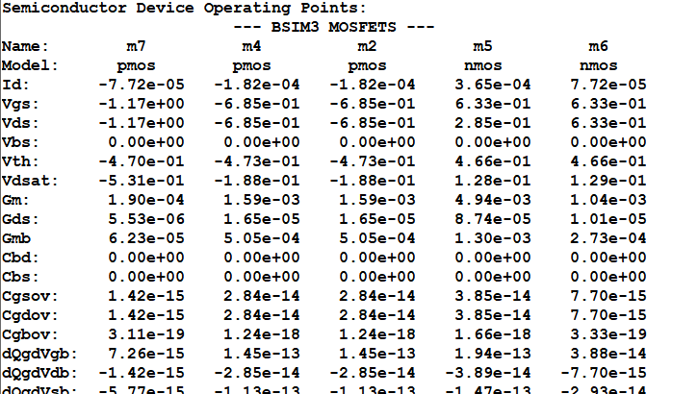
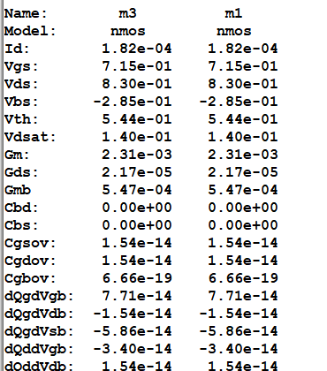
SPICE ERROR LOG

Slide 6
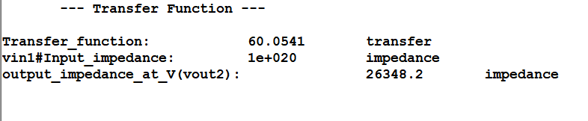
TRANSFER FUNCTION

Slide 7
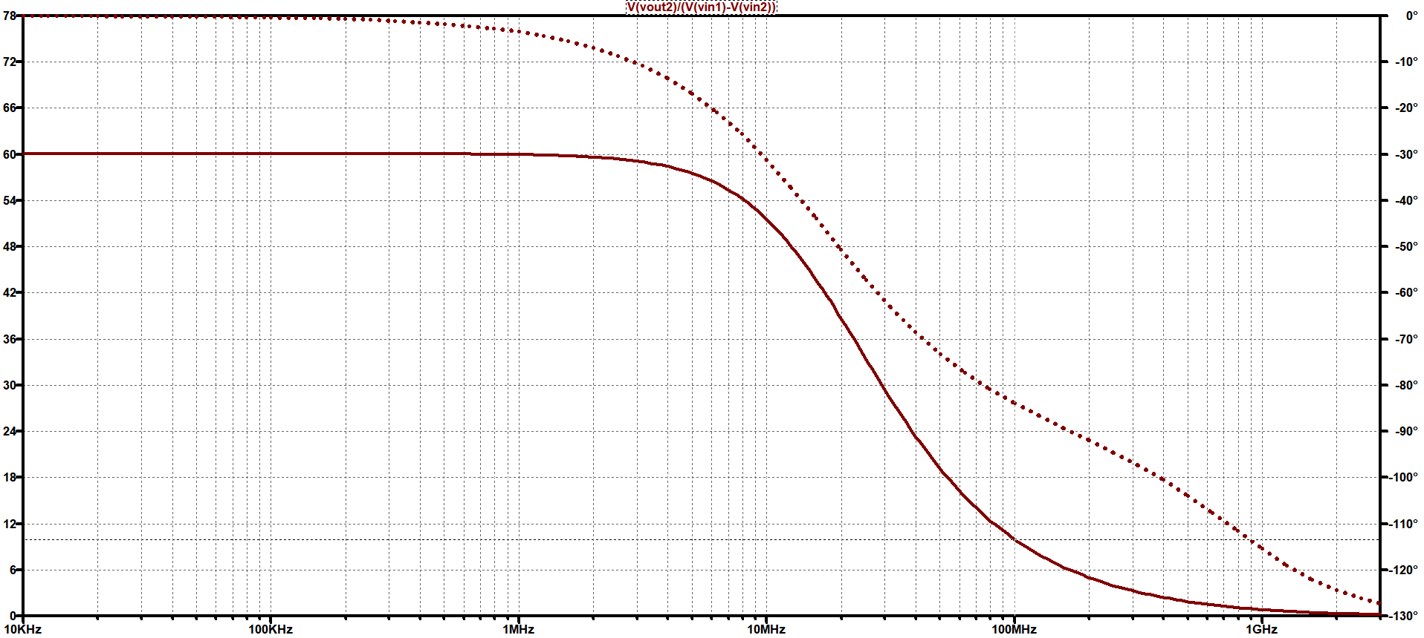
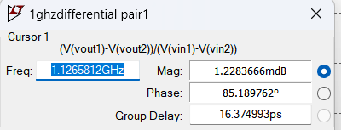
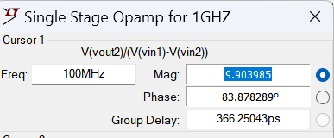
FREQUENCY RESPONSE
GAIN = 9.903

Slide 8
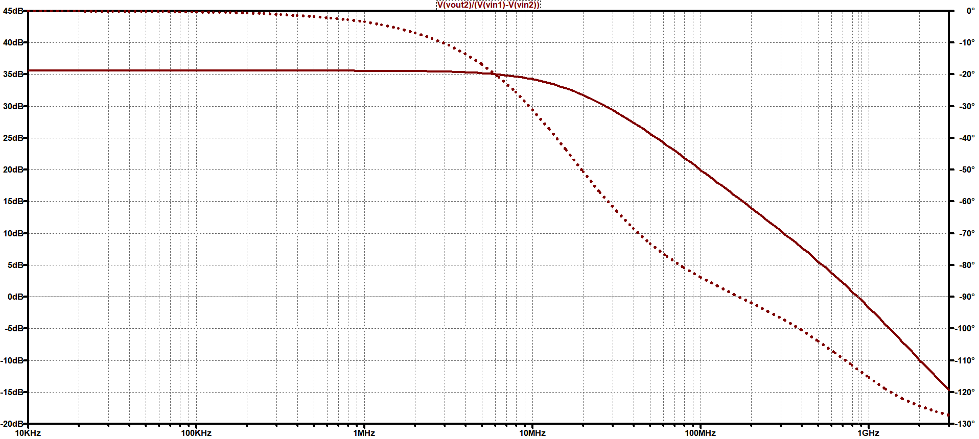
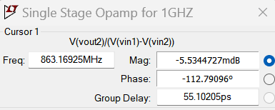
FREQUENCY RESPONSE
GBW=863.169MHz

Slide 9
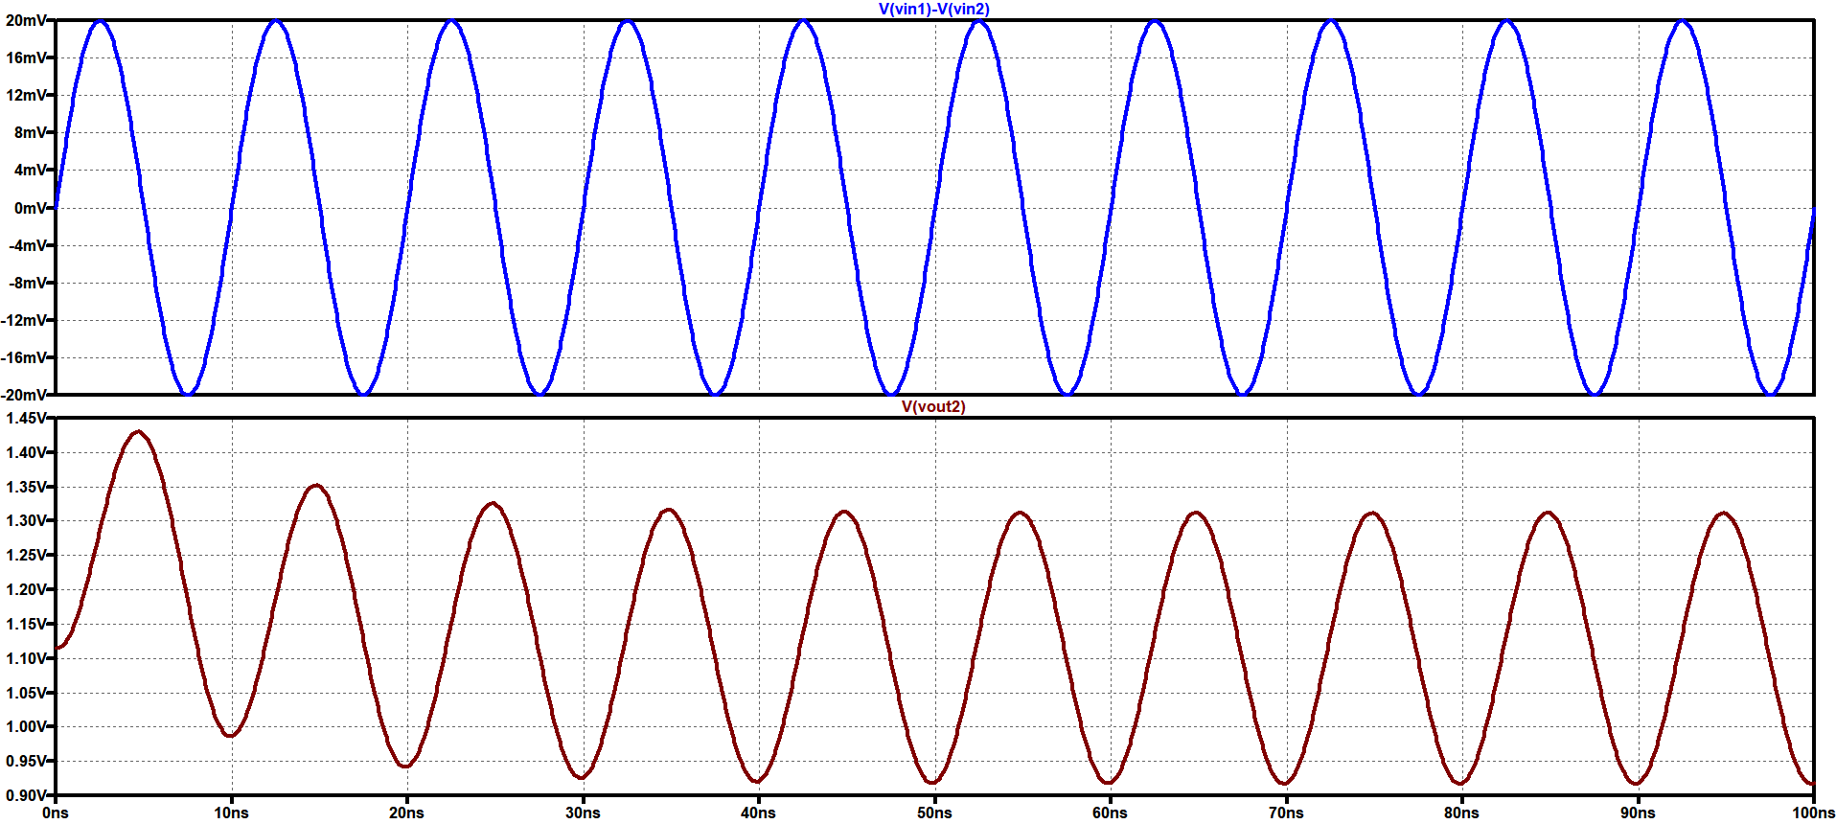
TRANSIENT ANALYSIS
If 10mV signal is given at 100MHz then by measuring peak to peak voltages
we can observe from here Gain is nearly 9.9

Slide 10
SUMMARY
SPECIFICATION | SIMULATION RESULTS
At 100MHz , Gain=10 | At 100MHz , Gain=9.903
GBW=1GHz | GBW=800MHz

Slide 11
COMMON SOURCE AMPLIFIER
Using pMOS AND CURRENT SOURCE LOAD
Model file : 180n
SPECIFICATIONS
GBW=1GHz , Gain = 10 at 100MHz

Slide 12

CALCULATIONS
GBW=1GHz , Gain = 10 at 100MHz
LET Gm=2mS (Practical value range 1-3 S given by Javed Sir)
USING $\text{C}\text{L}$= $\frac{Gm}{2π GBW}$ $\text{C}\text{L}$ =0.318pF (assume 0.3pF)
Now by Back calculation ,
$Gm$= $2π GBW\text{C}\text{L}$ =1.884mS
(For PMOS)
Vov=Vsg-|Vt|=1.8 – 1.1145 -0.44 Vov=0.2355V Id= $\frac{Gm Vov}{2}$= 221.8uA
Then , Gm/Id = 8.49 Id/W = 4.71 W=47u
(For NMOS)
Vgs=0.2355+0.45V=0.6855
Width of NMOS is taken by sweeping method
W=15.1546u

Slide 13
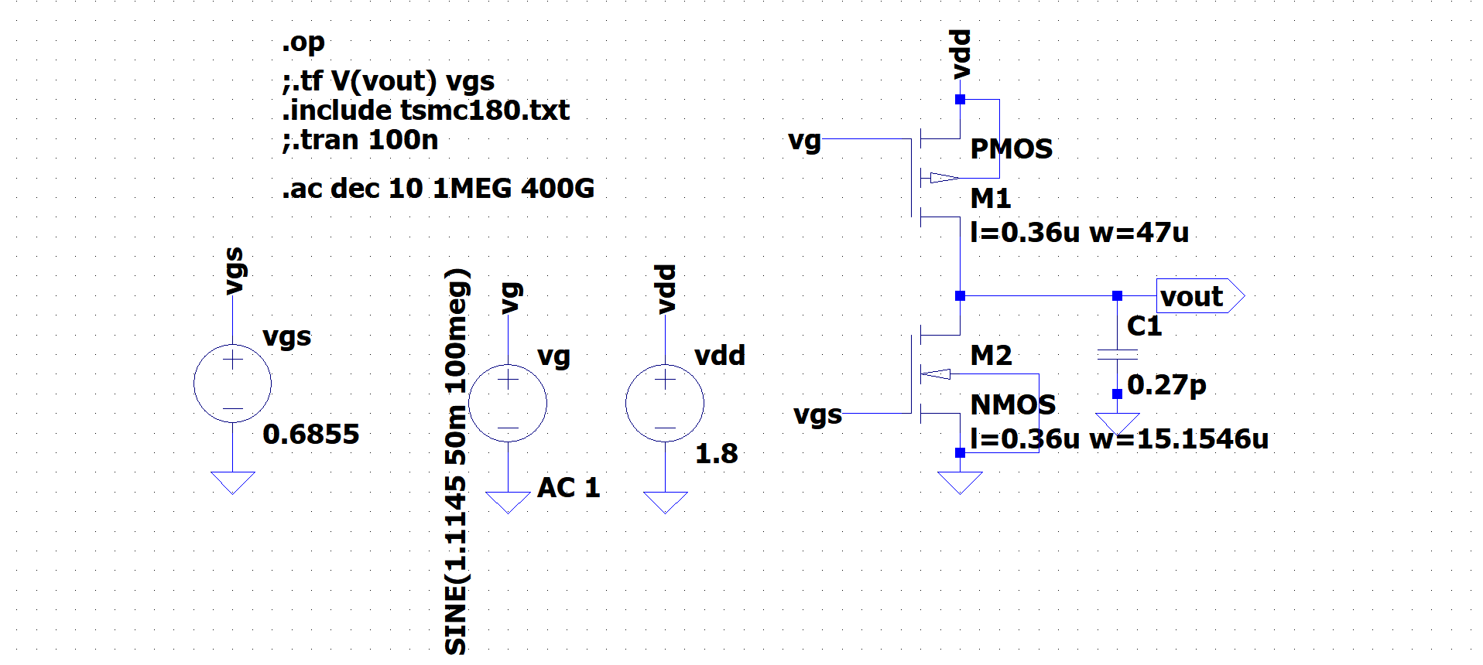
SCHEMATIC IN LT SPICE

Slide 14
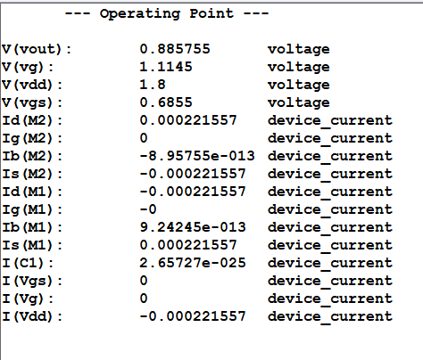
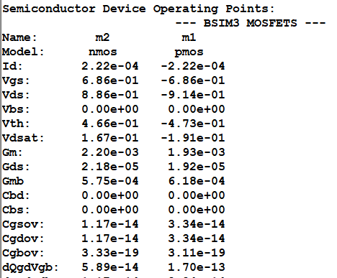
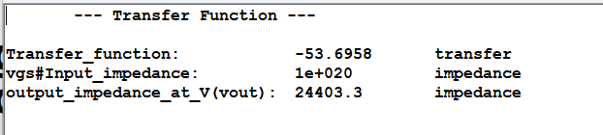

Slide 15
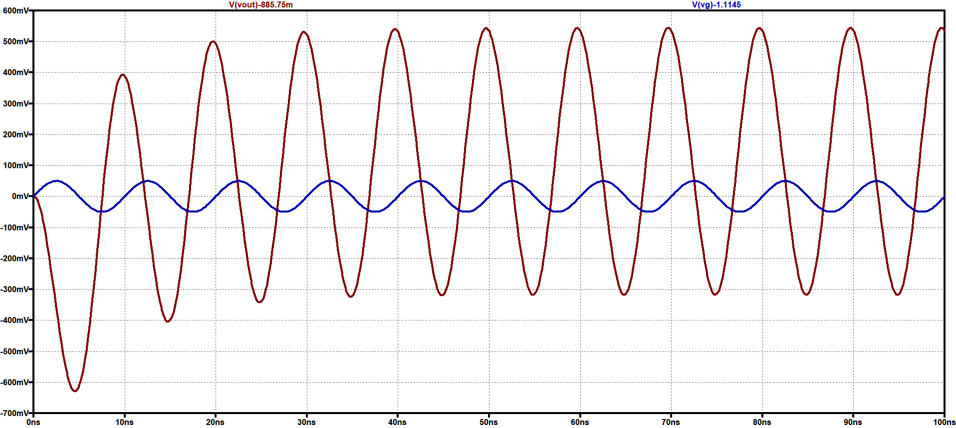
TRANSIENT ANALYSIS IN LT SPICE

Slide 16
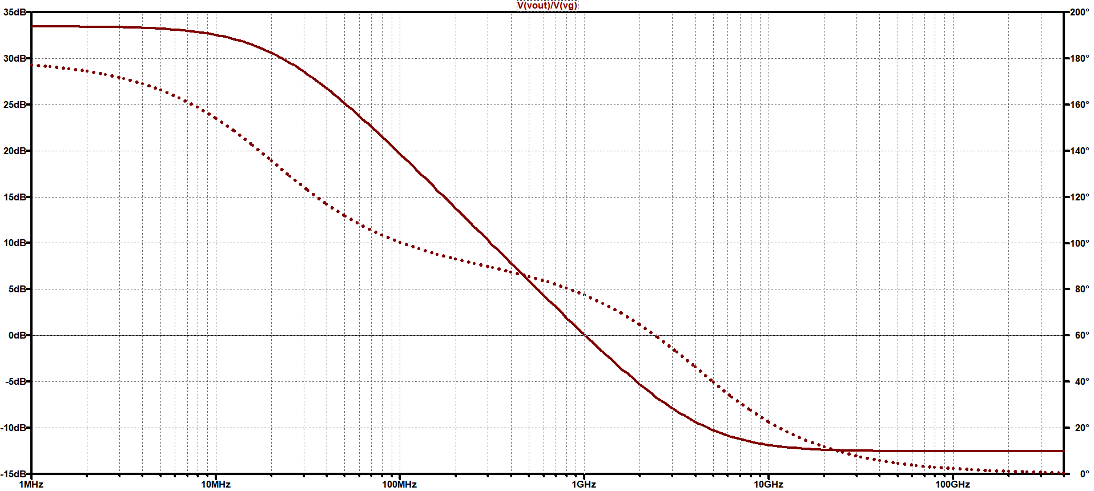
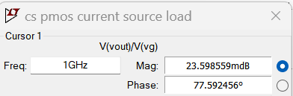
FREQUENCY RESPONSE IN LT SPICE

Slide 17
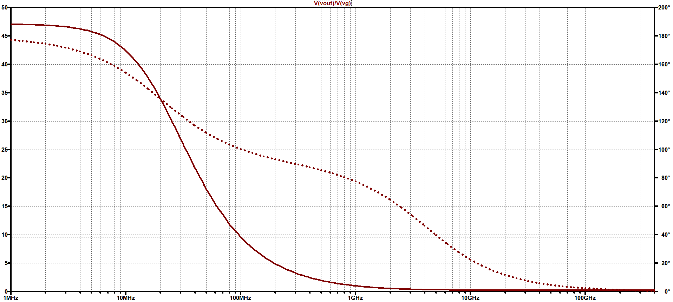
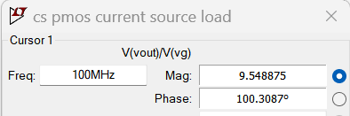
FREQUENCY RESPONSE IN LT SPICE

Slide 18
SUMMARY
SPECIFICATION | SIMULATION RESULTS
At 100MHz , Gain=10 | At 100MHz , Gain=9.54
GBW=1GHz | GBW=1GHz

Slide 19
TWO STAGE OPAMP
DESIGN AND SIMULATION using lt spice
Model file : 180n
SPECIFICATIONS
Gain > 60db i.e 1000

Slide 20
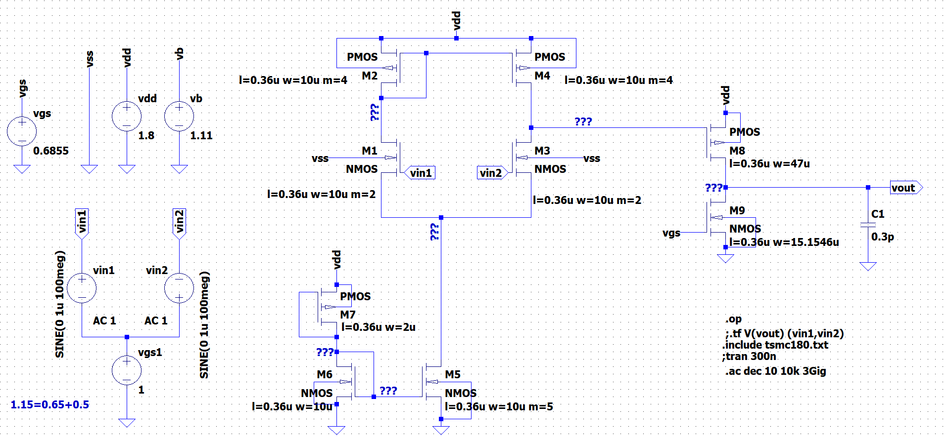
SCHEMATIC

Slide 21
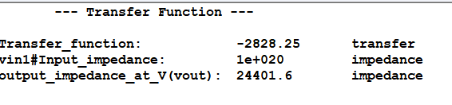

Slide 22
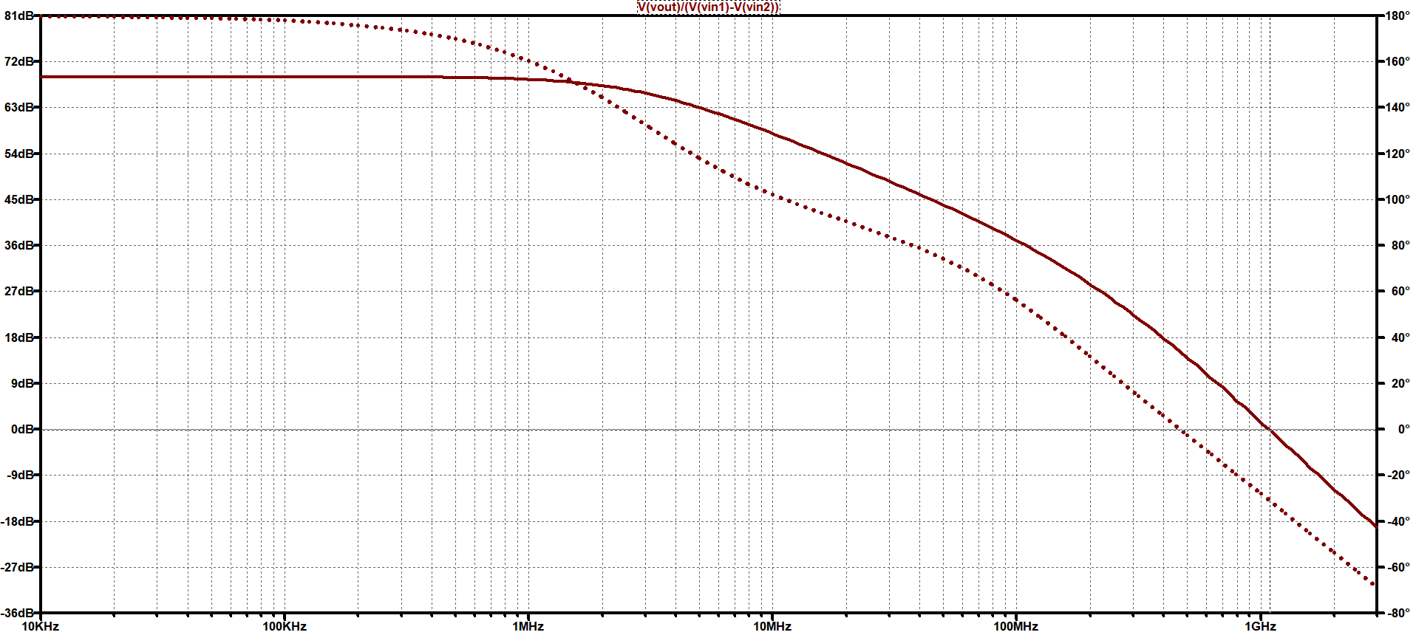
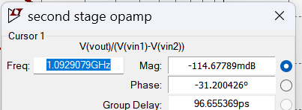
FREQUENCY RESPONSE IN LT SPICE
GBW=1.06GHz

Slide 23
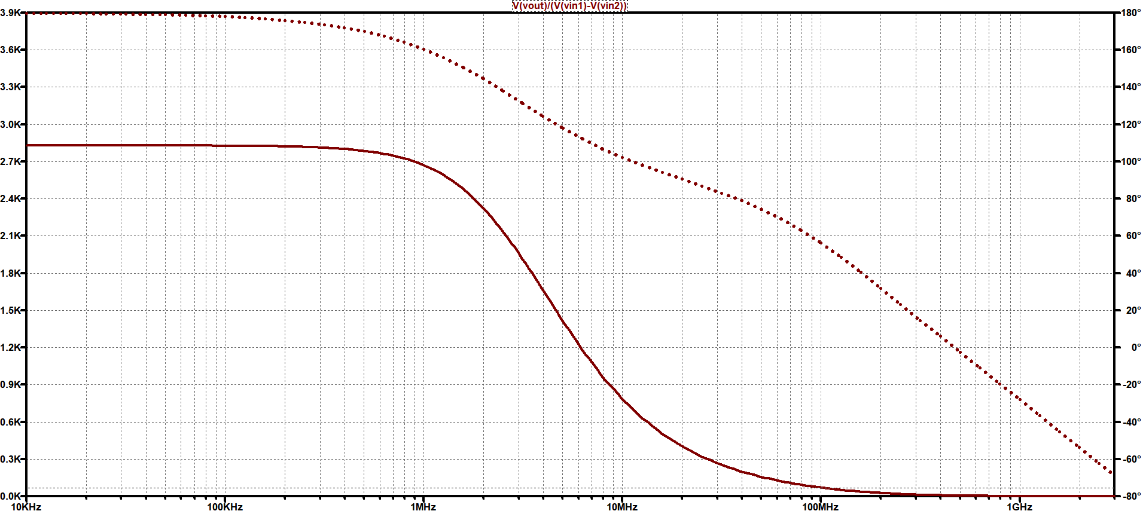
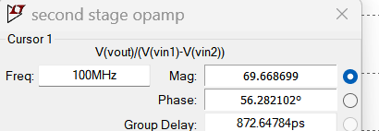
FREQUENCY RESPONSE IN LT SPICE
Gain at 100 MHz =69.99

Slide 24
SUMMARY
SPECIFICATION | SIMULATION RESULTS
Gain > 60db i.e 1000 | Gain=2828 which is Greater than 1000

Slide 25
THANK YOU

